Slide 1
The molecular role of galanin in parental behavior
Danielle Galvin

Slide 2
Introduce the characters
Galanin
Magnocellular preoptic area (POA)
Medial pallium (Mp)
Trpc2 gene
vomeronasal organ (VNO)

Slide 3
The molecular role of galanin in parental behavior
We will discuss…
Role in POA
Role in Mp
Trpc2 gene

Slide 4
What is known so far
Previous work in mammals, birds
New work: amphibians
Galanin neurons
Vary in location
Notes:
Galanin neurons vary in location throughout amphibian development

Slide 5
How does galanin modify parental behavior?
What molecular mechanisms are involved?
What regions are involved?
What is the effect?

Slide 6
My own hypothesis
Galanin neuron signaling in the vomeronasal system activates the Trpc2 gene which is necessary for parental behavior to occur in amphibians.

Slide 7
galanin
Neuropeptide
Brain, spinal cord, and gut
G protein-coupled receptors
Variety of roles
Notes:
Three g protein coupled receptors
Variety of roles including parental behavior, cognition, regulation of blood pressure, regulation of mood, depression, Alzheimer’s. Co localized with transmitters such as acetylcholine, serotonin, and norepinephrine.

Slide 8
Galanin Receptor 1
GALR1 gene
Inhibits adenylyl cyclase
GI/GO family
Expression
Brain, Spinal cord
Small intestine, Heart
Notes:
Inhibition occurs via a G protein of the Gi-GO family
Expressed in the brain, spinal cord, small intestine, and heart

Slide 9
GALANIN RECEPTOR 2
GALR2
N-terminal residues of galanin peptide
Signaling mechanism
Phospholipase C/Protein kinase C

Slide 10
Galanin Receptor 3
GALR3
Located in many different tissues
Mode of action unclear
Expressed in 1.4-, 2.4-, and 5-kb transcripts

Slide 12
Galanin Locations in mice
Central nervous system
Highest concentration in hypothalamus
Gastrointestinal tract
Skin
Anti-inflammatory

Slide 13
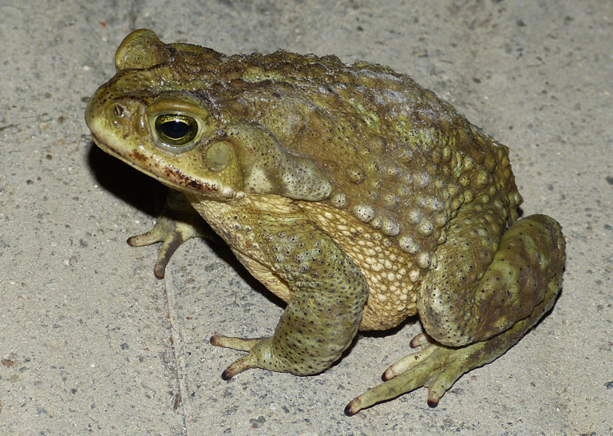
Galanin in amphibians
Rhinella arenarum collected from the wild
Argentine toad
Tissues processed and analyzed
Gosner stages
Notes:
Tissues from different life stages were processed and analyzed

Slide 14
Premetamorphic (26-30)

Slide 15
Prometamorphic (30-41)
Prometamorphic (30-41)

Slide 16
Metamorphic climax (42-46)

Slide 17
Quantification of Galanin cells
Tissue slides stained:
Positions
Shape
Stain saturation
POA and Mp
Notes:
Tissue slides were stained to determine distribution of gal-ir fibers and perikaryal in the brain

Slide 18
Magnocellular preoptic area
Region of the hypothalamus
Parental care
Sexual behavior
Thermoregulation

Slide 19
medial pallium
Homologue of mammalian hippocampus
Parental care?
Expression of various genes
Galanin
Associated with spatial memory

Slide 20
Gal-IR cells POA: Premetamorphic

Slide 21
Prometamorphic gal-ir fibers in MP

Slide 22
Metamorphic climax Gal-ir fibers in POA

Slide 23
Galanin distribution in amphibians
Development of galanin neurons
Compare to adult brains
Function of galanin throughout development
Notes:
Comparing the distribution of galanin neurons between a metamorph and an adult may provide insight when evaluating the distribution in the context of different behaviors

Slide 24
Relationship between parental behavior and galanin?
Whole brains collected
DAPI nuclear staining
Identify brain regions
Quantify galanin neurons
Cell counts

Slide 25
PhosphoTRAP
Profile activated neurons
Gene expression quantified
Mapping sequenced reads
Kallisto to estimate abundance
Notes:
Kallisto: program for identifying abundance of transcriptomes

Slide 26
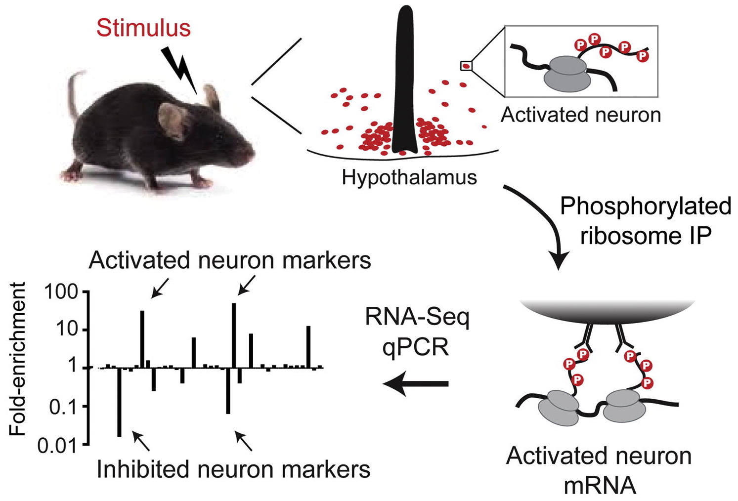
Neural induction during tadpole transport

Slide 27
Neural induction during tadpole transport
Biparental, monogamous vs. male, uniparental species
Brain regions involved in parental care
POA and Mp
Notes:
Greater similarity between the results of neural induction in biparental monogamous species when compared to male uniparental species

Slide 28
Differences in neural activity between partners

Slide 29
Medial pallium Ps6-positive galanin cells
NP
T
NP
T
NP
T
Notes:
Green: significant different between parental and non parental
Blue: Significant difference between non transporting females and transporting males
OrangeL Signsificant difference between transporting and non transporting females

Slide 30
Anterior preoptic area Ps6-positive galanin cells
NP
T
NP
T
NP
T
Notes:
Green: Significant difference between non transporting males and transporting females, between non transporting females and transporting males, and between non transporting and transporting females
Blue: significant difference between non transporting parents and transporting males
Organe: no significance

Slide 31
Magnocellular preoptic area ps6-positive galanin cells
Notes:
Green: Significant difference between non transporting females and transporting parents
Blue: No significance
Orange: Significant difference between non transporting and transporting females

Slide 32
Galanin and parental behaviors
Activation of galanin overlaps with regions active during parental behavior
…..How does it work??
…..Trpc2 gene?

Slide 33
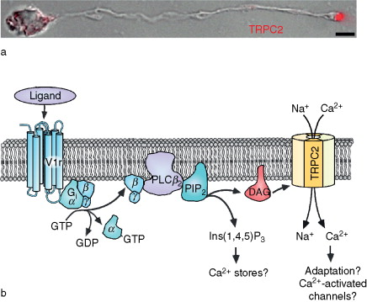
Notes:
Ligand binds to the vomeronasal 1 receptor. The alpha, beta and gamma g-protein subunits separate with the beta and gamma subunits binding to phospholipase C. Phospholipase C hydrolyzes phosphatidylinositol 4,5 biphosphate which will result in the production of two second messengers: inositol 1,4,5triphosphate and diacylglycerol. Diacylglycerol activates a cation channel, triggering TRPC2 signalling.

Slide 34
Trpc2 Gene
Encodes vomeronasal organ (VNO) ion channel
Ablation impairs VNO signaling
Role in parental behavior and aggression
Mice
Amphibians?

Slide 35
Trpc2 gene
Expressed only in VNO in amphibians
Main olfactory epithelium (MOE) in mice
Mediate transduction of chemical signals
Pheromones
Many tetrapods have TRPC2 gene
Regardless of whether VNO is present

Slide 36
TRPC2 gene
Activated by G-proteins
Trpc2 in VNO and the MOE may have different roles
Not well understood

Slide 37
TRPC2 gene in mice
VNO signaling necessary for gender identification
Deficient males vs. females
Genetic ablation
Virgin males
Virgin females
Notes:
VNO deficient males will mount either male or female mice while VNO deficient females exhibit male-like mounting behaviors. Leads to the idea that VNO suppresses male-specific behavior circuits in the female brain
Ablation in virgin males results in loss of pup directed aggression as well as increased parental care
Ablation in virgin females displayed more parenting behaviors than the ablated virgin males

Slide 38
TRPC2 gene in amphibians?
Not well researched
Pheromone detection
Pheromone role in parental behavior?

Slide 39
Pheromone detection and parenting behavior?
Pheromone detection necessary for individual detection
Discern offspring

Slide 40
Galanin in mice
Ablation of medial preoptic area (MPOA) gal+ neurons in Gal-cre mice
MPOA gal+ neurons express Cre
Bilateral injection of AAV-DTA
Eliminated 60% of MPOA gal+ cells
Notes:
AAV-DTA is AAV expressing cre-dependent diphtheria toxin A fragment
This injection eliminated 60 % of MPOA gal cells and the gal cells in other regions were unaffected

Slide 41
Maternal behavior correlates with number of gal cells

Slide 42
Higher proportion of gal cells present correlates with higher retrieval rates in females

Slide 43
Ablation of MPOA gal+ neurons in mice
Virgin females reduced maternal behavior
Emergence of pup-directed aggression
Maternal behavior and galanin
Notes:
Emergence of pup-directed aggression accompanied by reduced crouching, nest building, retrieval to nest, and maternal interaction (over 50% ablated)
Duration of any maternal behavior directly correlated with remaining amount of galanin neurons (under 50% ablated)

Slide 44
Ablation of MPOA gal+ neurons in mice
Nursing mothers
Over 50% ablation: failed to retrieve pups
Parental males
Over 50% ablation: disappearing parental behavior
Notes:
Deficits in crouching, pup grooming, nest building, retrieval to nest, and overall paternal interaction
Control mothers successfully retrieved all 4 pups

Slide 45
Females with higher ablation success reduce maternal behavior

Slide 46
Higher ablation success correlates with disappearing paternal behavior

Slide 47
Ablation of MPOA gal+ neurons in mice
Inter-male aggression: no effect
Locomotion: no effect
Mounting duration: decreased
Latency to mount: increased

Slide 48
Galanin or tyrosine hydroxylase?
Ablation of MPOA tyrosine hydroxylase (Th) cells
Th-IRES-Cre males
AAV-DTA injection to MPOA
70% of Th+ cells were ablated in MPOA

Slide 49
Galanin!
Ablation of MPOA tyrosine hydroxylase (Th) cells
No effect on male parental behaviors
Role of gal+ cells in parental behavior
Notes:
No effect on behavior parenting, mating, or inter-male aggression in male subjects

Slide 50
Optogenetic activation of gal+ neurons
Gal-Cre males given MPOA-targeted injections
Blue light delivered to MPOA
Male contacted pup with snout
Notes:
Gal-cre males are transgenic mice…. What does the cre mean?

Slide 51
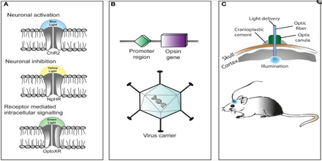
Wu et. al. Methods

Slide 52
Optogenetic activation of gal+ neurons
Virgin males:
Light stimulation inhibited attacking of pups
Stimulation did not alter behavior of control males
Notes:
Loss of pup-directed aggression not due to pup avoidance

Slide 53
Optogenetic stimulation of male gal-cre mice reduces pup directed aggression

Slide 54
Optogenetic stimulation of male gal-cre mice increases pup grooming behavior

Slide 55
Optogenetic activation of gal+ neurons
Fathers
Light stimulation elevated pup grooming
Suppressed pup-directed aggression

Slide 56
Optogenetic stimulation of male gal-cre mice decreases the duration of crouching, increases duration of pup grooming

Slide 57
Galanin In mice: take away
Galanin secreting cells influence parental behavior
Absent: decreased parenting behavior
Present: increase in parenting behavior

Slide 58
Role of galanin in amphibians
Galanin is found in various
Various concentrations throughout development
Location is important in determining role
Behavioral effects?
Parenting behavior??

Slide 59
Amphibian parenting behaviors
Tadpole transport
Feeding tadpoles
Incubation/protection
Back, stomach/mouth

Slide 60
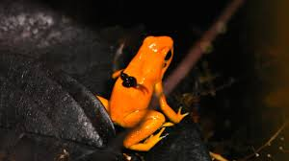
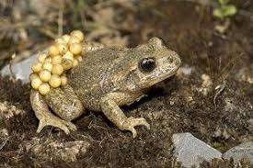
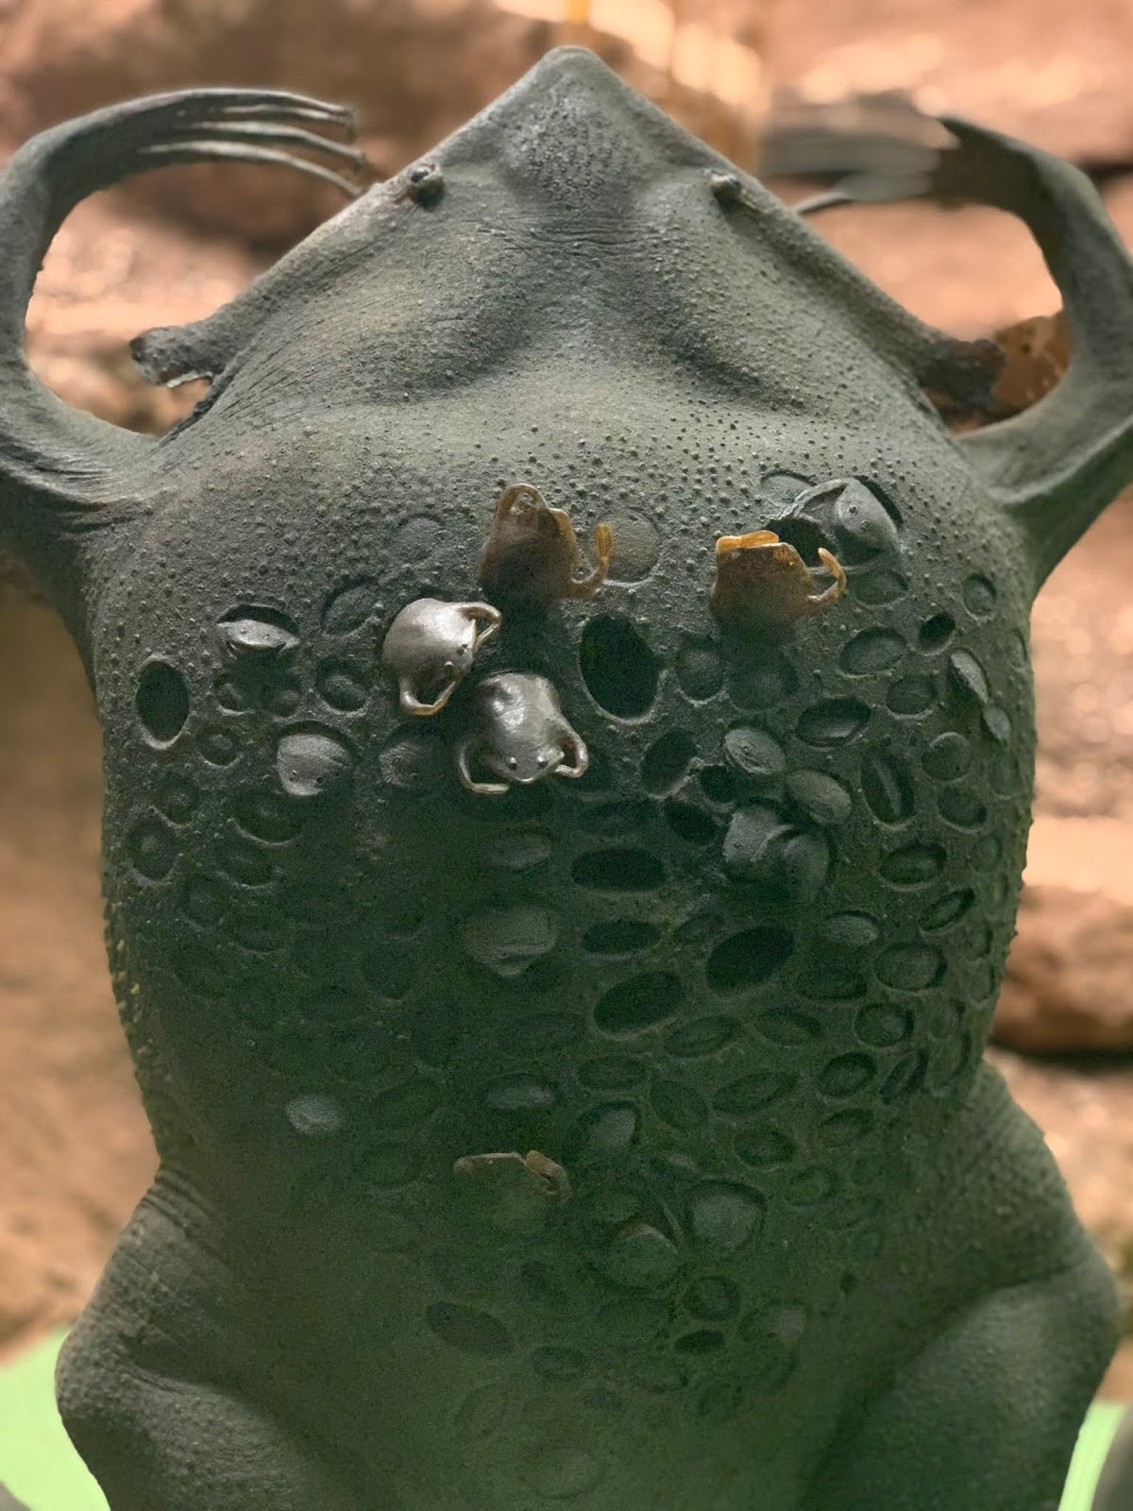
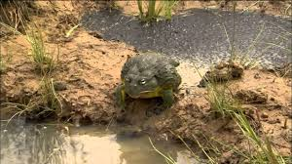
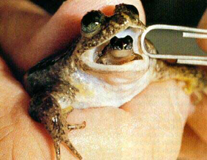

Slide 61
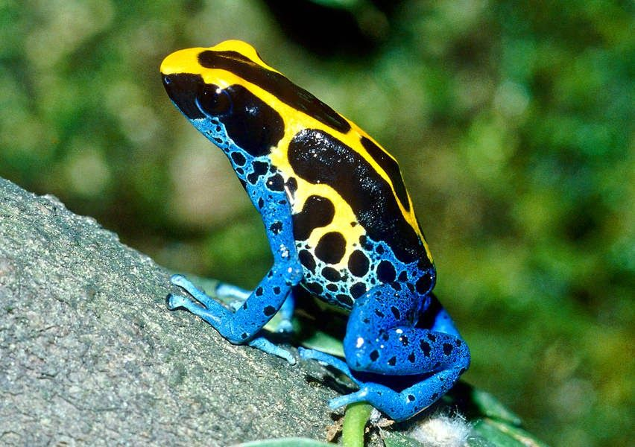
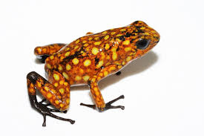
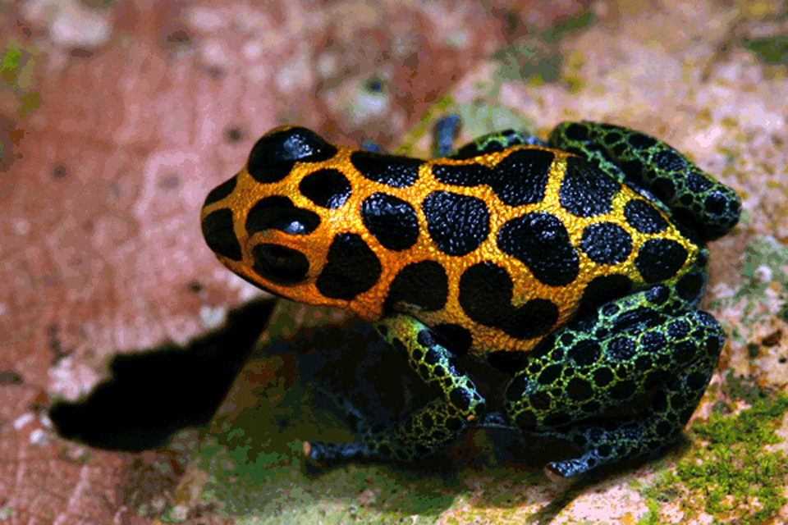
Dendrobatid parenting behavior
Dendrobatids
Collection
Parenting strategies
Dendrobates tinctorius
Oophaga sylvatica
Ranitomeya imitator

Slide 62
Parenting behaviors of the focus Dendrobatids

Slide 63
Recap
What molecular mechanisms are involved?
Galanin
Activity promotes parental behavior
Trpc2 gene
Pheromone detection
Olfactory signaling

Slide 64
Recap
What regions are involved?
Preoptic area
Medial pallium
Vomeronasal organ

Slide 65
Recap: galanin
What is the effect?
Increased signaling influences parental behavior
Variety of parental care systems
Multiple factors influence role of galanin in modifying behavior

Slide 66
Recap: galanin and parental care
Galanin conserved throughout multiple lineages
Mammals
Birds
Amphibians
Role in parental care now being considered

Slide 67
Recap: Trpc2 gene
What is the effect?
Pheromone detection
Vomeronasal signaling
Role in individual detection?
Related to identification of offspring?

Slide 68
Using the mouse to understand the frog
Trpc2 and galanin role in mouse parental care
Galanin found in POA for both
Mp and hippocampus
Trpc2 located in VNO
Role understood in mice, not amphibians

Slide 69
Using the mouse to understand the frog
Due to similarities…
Research done in mice can inform future directions in amphibians
Spatial learning?

Slide 70
Support for hypothesis?
Hypothesis: Galanin neuron signaling in the vomeronasal system activates the Trpc2 gene which is necessary for parental behavior to occur in amphibians.
Trpc2 gene and galanin are connected in other species
Amphibians?
Maybe!

Slide 71
Is there a new problem?
Can this amphibian system be expanded?
Other amphibian groups
What about other systems?
Reptiles
What about the role in other parental care systems?
Gastric brooding, trenching, back incubation

Slide 72
take-home messages
1. Galanin plays a role in parental behavior in mammals and amphibians
2. Preoptic area and medial pallium plays a role in parental behavior
3. Trpc2 necessary for pheromone detection, potential role in parental behavior

